Slide 1
Fluent Python Chapter 4: Text vs Bytes
Chaochih Liu

Slide 2
String vs. Character

Slide 3
What is a string?

Slide 4
“A string is a sequence of characters.”

Slide 5
What is a character?

Slide 6

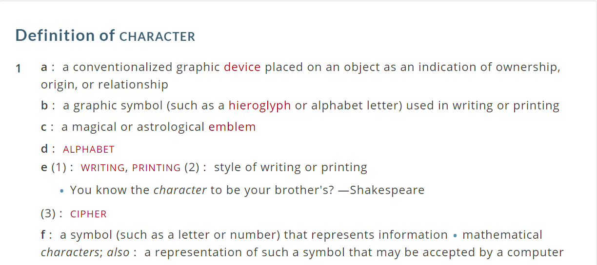

Slide 7
Encoded character

Slide 8
Unicode character

Slide 9
What is a Unicode character?
Character encoding standard
Separates identity of characters from specific byte representations
Unicode string is a sequence of code points

Slide 10


Code Points
Identity of a character
Numbers from 0 through 1,114,111 decimal
Shown as 4 to 6 hexadecimal digits with “U+” prefix
Examples
Code point for A: U+0041
Code point for Euro sign: U+20AC
Code point for G clef: U+1D11E
Notes:
hexadecimal: describes base-16 number system
number system containing 16 sequential numbers as base units (including 0) before adding new position for next number
Are 0-9 then use letters A-F

Slide 11
Python and Unicode characters
Python 3.4 – standard used is Unicode 6.3
Python 3
Get Unicode characters from items in str
Python 2
Get Unicode characters from items of a Unicode object
Get raw bytes from str

Slide 12
bytes that represent a character depend on the encoding used
Notes:
converting code points to bytes

Slide 13
Encodings

Slide 14
Encodings
Rules for converting Unicode string into sequence of bytes
Example: Array of 32-bit integers
Notes:
This encoding is straightforward but has problems:
Not portable, different processors order bytes differently
Wasteful of space
Not compatible with existing C functions (i.e. strlen())
Many internet standards are defined in terms of textual data, can’t handle content with embedded zero bytes

Slide 15
Most Commonly Used Encodings
UTF-8
UTF means Unicode Transformation Format
8 means 8-bit numbers are used
UTF-8 Rules
If code point is < 128, represent by corresponding byte value
If code point is >= 128, turn into a sequence of two, three, or four bytes
Each byte is between 128 and 255

Slide 16
UTF-8 Encodings
Example
Code point for letter A: U+0041
Letter A UTF-8 encoded as single byte: \x41

Slide 17
Decoding
Rules used to convert from bytes to code points

Slide 18
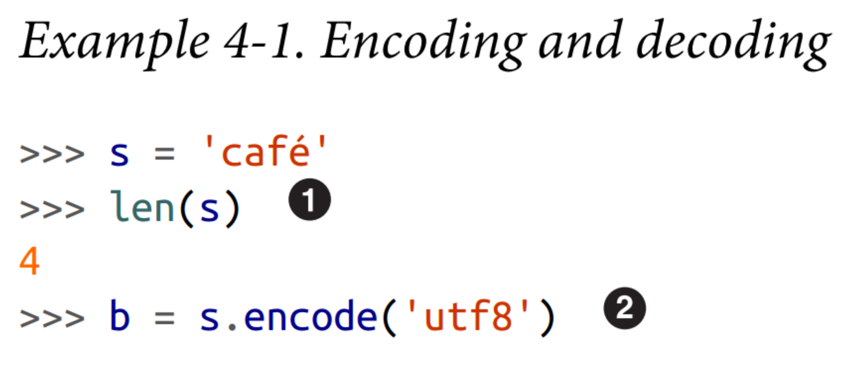
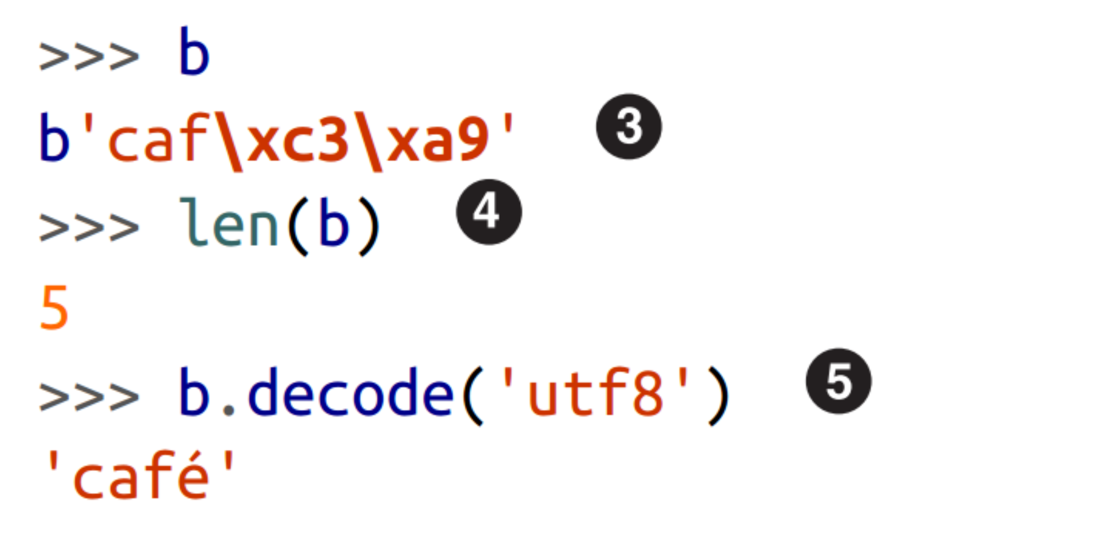
Notes:
str ‘cafe’ has four Unicode characters
Encode str to bytes using UTF-8 encoding
bytes literals start with a b prefix
bytes b has five bytes (code point for “e” is encoded as two bytes in UTF-8
Decode bytes to str using UTF-8 encoding

Slide 19
Encoding and Decoding Summary
Byte sequences: cryptic machine core dumps
Unicode str objects: “human” text
Decode bytes to str for human-readable text
Encode str to bytes for storage/transmission

Slide 20
Binary sequence types

Slide 21
Binary sequences
Two built-in types
immutable bytes
mutable bytearray

Slide 22
bytes and bytearray
Each item is an integer from 0 to 255
Slice of binary sequence always produces binary sequence of same type

Slide 23
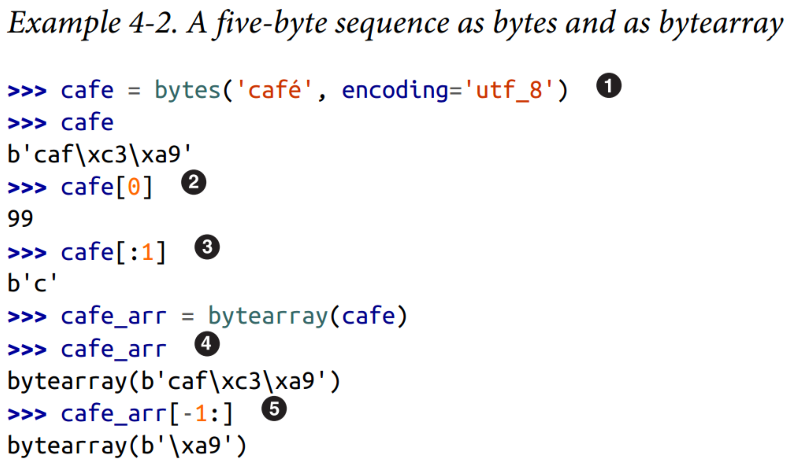
Notes:
bytes can be built from a str, given an encoding
Each item is an integer in range(256)
Slices of bytes are also bytes – even slices of a single byte
There is no literal syntax for bytearray: they are shown as bytearray() with a bytes literal as argument
A slice of bytearray is also a bytearray

Slide 24
bytes and bytearray supported methods
Supported methods
Not supported methods
endswith
replace
strip
translate
upper
regex in re module
and more...
format
format_map
casefold
isdecimal
isidentifier
isnumeric
isprintable
encode
Notes:
Supports every str method with a few exceptions
Can use these methods with binary sequences

Slide 25
Structs and Memory Views

Slide 26
Structs and memory views
struct module
parse packed bytes into tuple of fields of different types
perform opposite conversion, from tuple to packed bytes
used with bytes, bytearray, and memoryview objects
memoryview class
provides shared memory access to slices of data
binary sequences
packed arrays
buffers

Slide 27
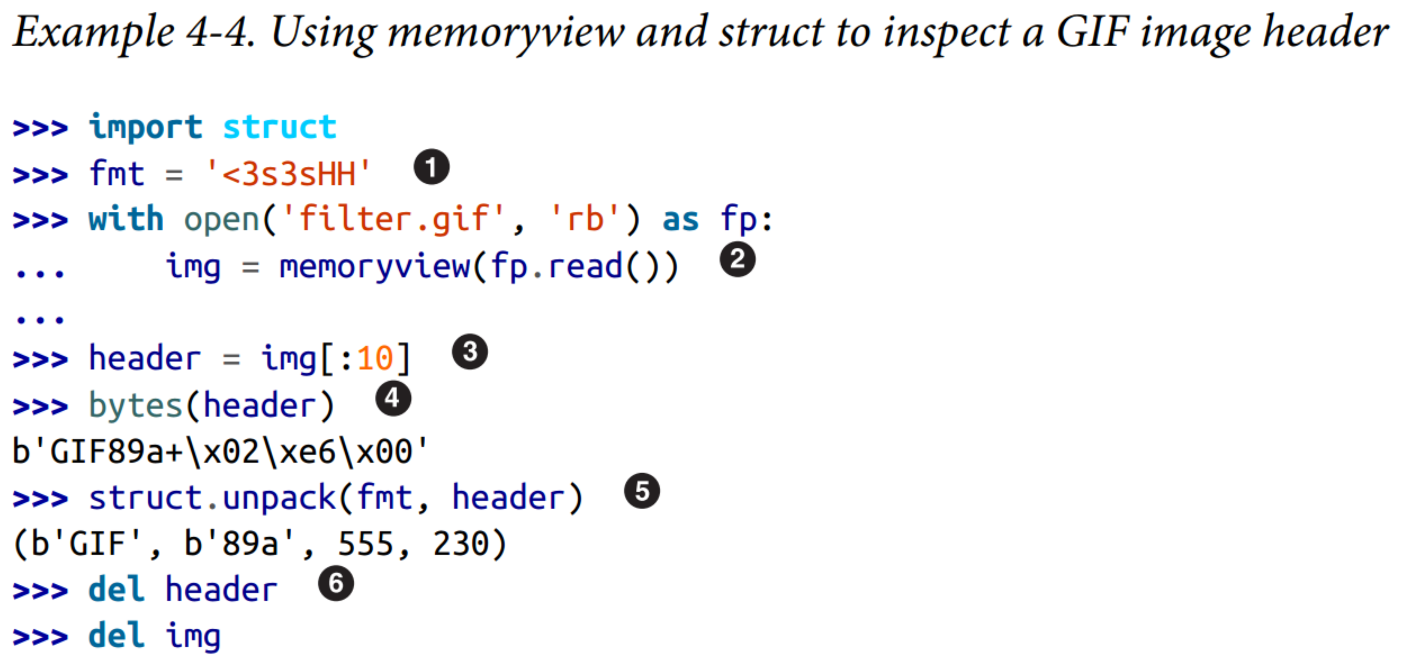
Notes:
struct format: <little-endian; 3s3s two sequences of 3 bytes; HH two 16-bit integers
Create memoryview from file contents in memory
then another memoryview by slicing the first one, no bytes are copied here
convert to bytes for display only; 10 bytes are copied here
Unpack memoryview into tuple of: type, version, width, and height
Delete references to release the memory associated with the memoryview instances

Slide 28
Basic Encoders/Decoders

Slide 29
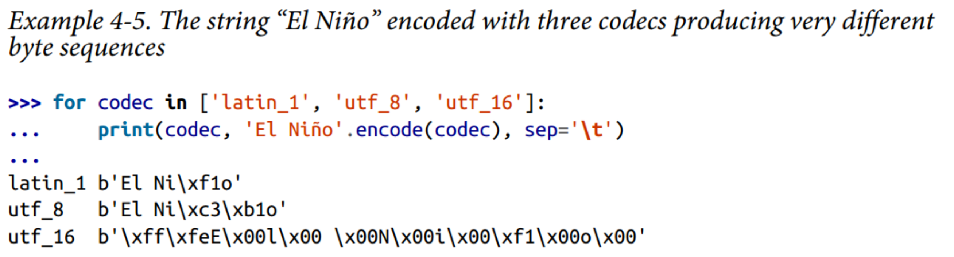
Basic Encoders/Decoders
Python distribution bundles > 100 codecs (encoder/decoder)
text to byte conversion
byte to text conversion
Notes:
Can specify encoding argument in functions like open(), str.encode(), bytes.decode()
Ex 4-5: shows same text encoded as three different byte sequences

Slide 30
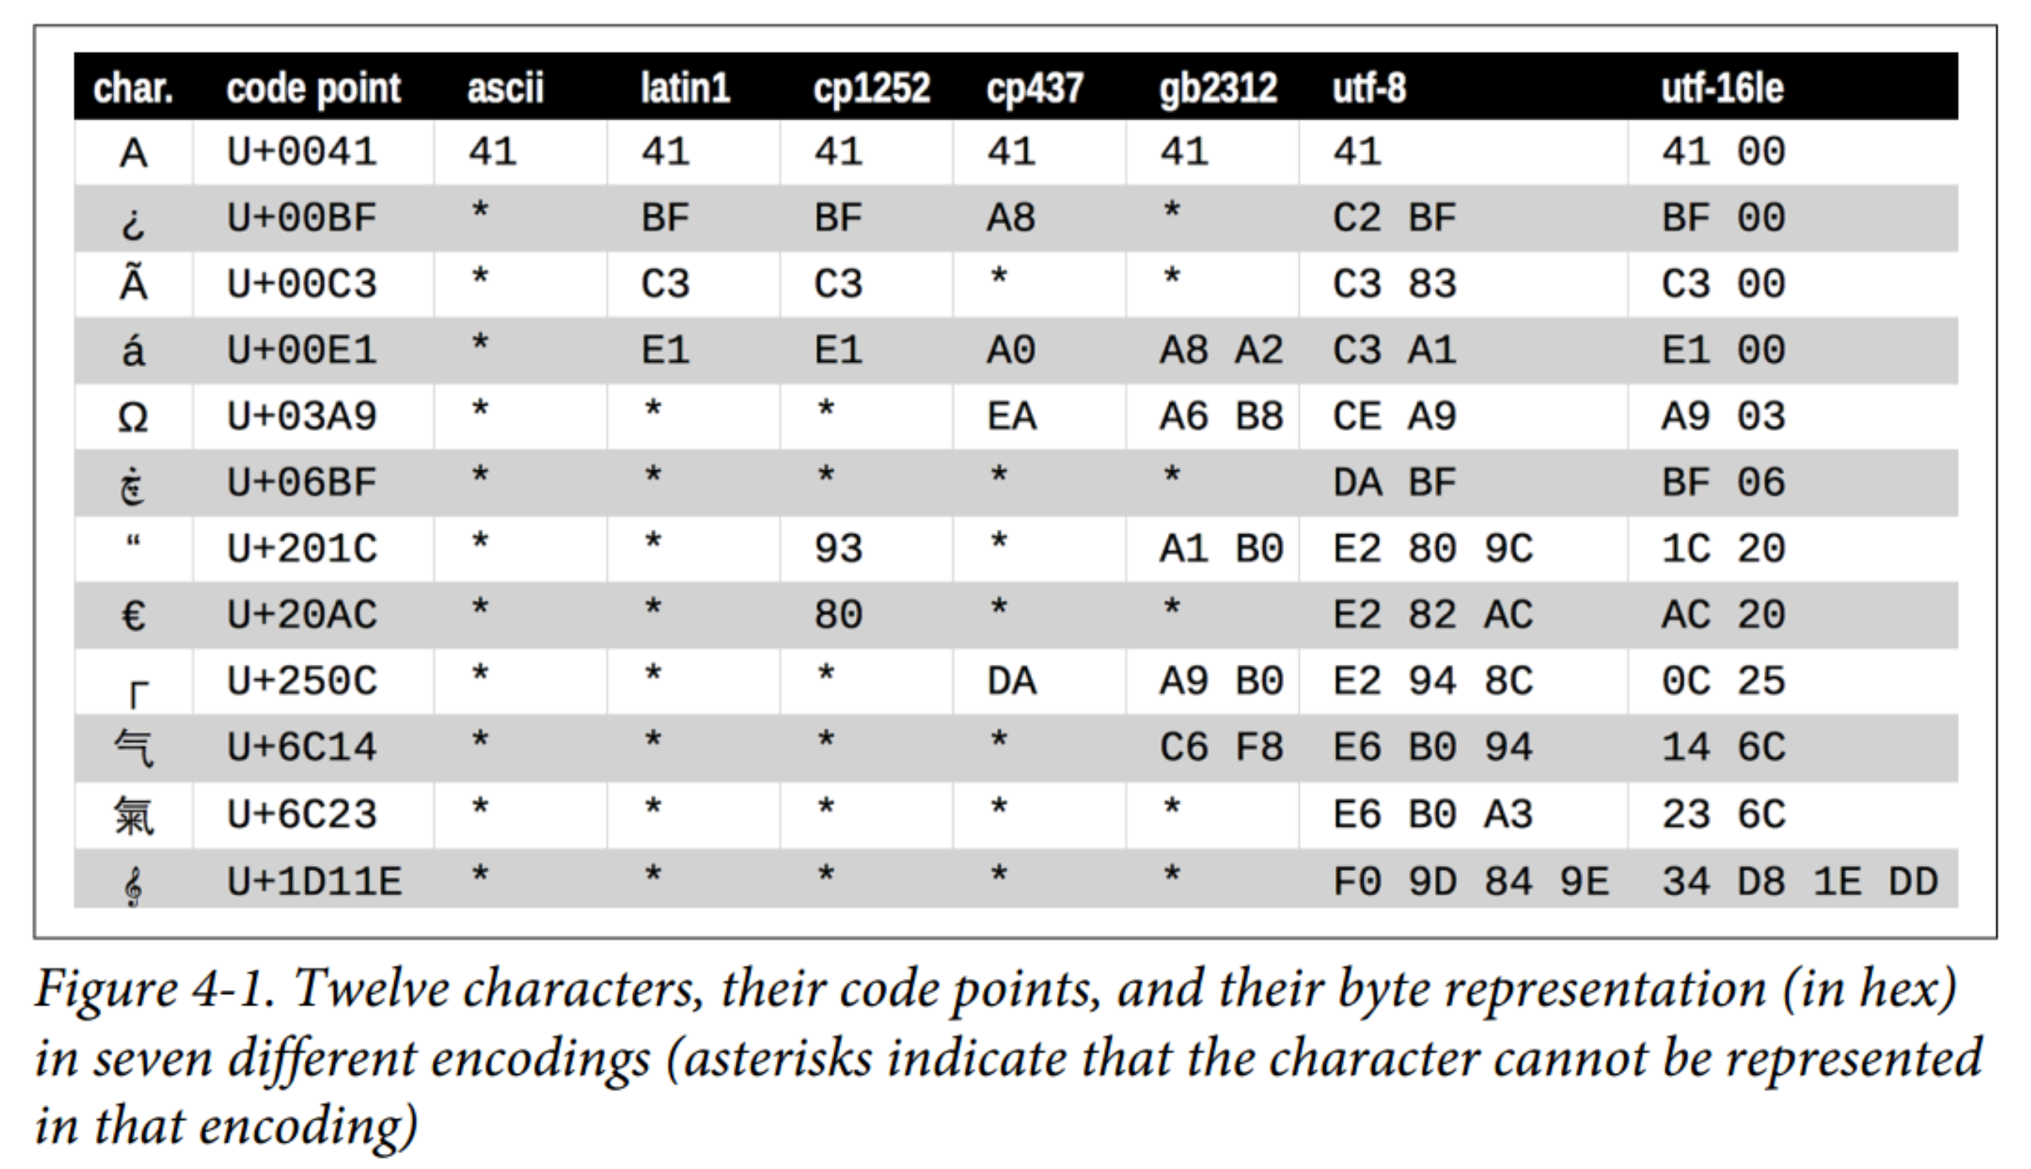
Notes:
Why have so many different encodings?
Some encodings cannot represent every Unicode character
Ex. ascii and gb2312

Slide 31
Understanding Encode/Decode Problems

Slide 32
Generic UnicodeError exception
UnicodeEncodeError
when converting str to binary sequences
UnicodeDecodeError
when reading binary sequences into str
SyntaxError
loading Python modules when source encoding is unexpected

Slide 33
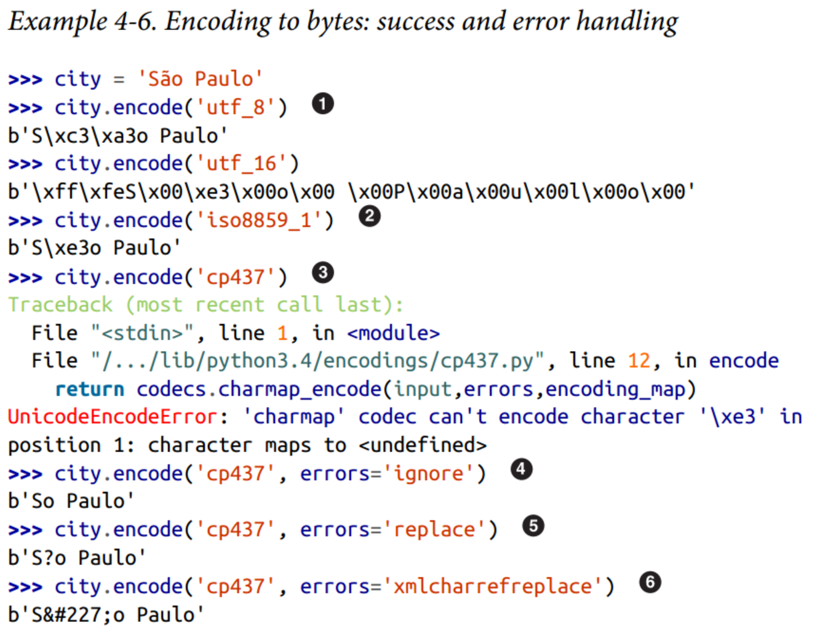
Notes:
UnicodeEncodeError when converting text to bytes if a character is not defined in target encoding
Example of behavior of error handlers
utf_? encodings handle any str
iso8859_1 also works for ‘Sao Paulo’ str
‘cp437’ can’t encode the ‘a’ with tilde. The default error handler –’strict’- raises UnicodeEncodeError
error=‘ignore’ silently skips characters that can’t be encoded (very bad idea)
When encoding, error=‘replace’ substitutes unencodable characters with ‘?’; data is lost, but users will know something is amiss
‘xmlcharrefreplace’ replaces unencodable characters with an XML entity

Slide 34
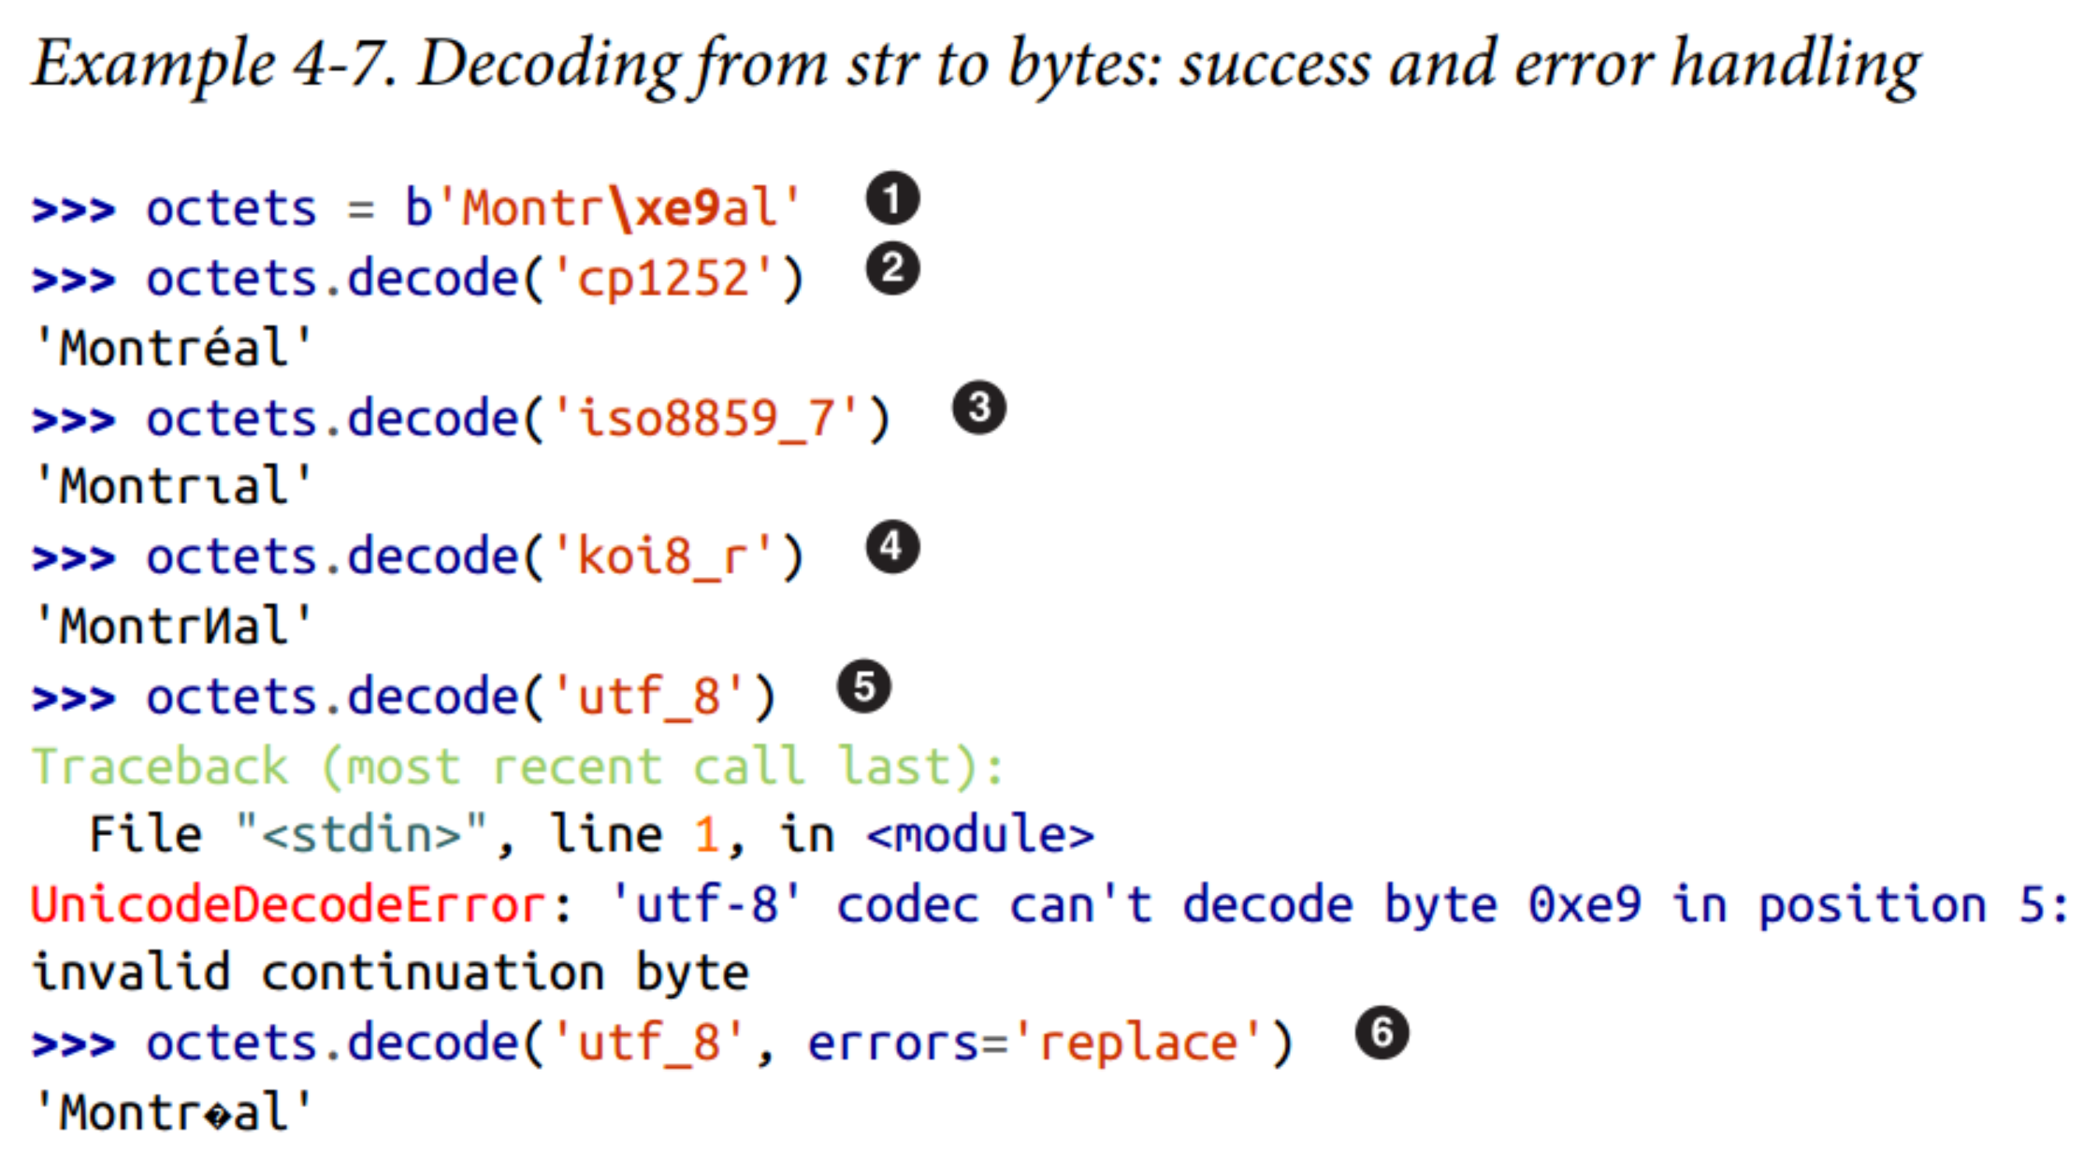
Notes:
These bytes are the characters for Montreal encoded as latin1; ‘\xe9’ is the byte for “e”
Decoding with ‘cp1252’ (Windows 1252) works because it is a proper superset of latin1
ISO-8859-7 is intended for Greek so the ‘\xe9’ byte is misinterpreted, and no error is issued
KOI8-R is for Russian. Now ‘\xe9’ stands for the Cyrillic letter “N”
The ‘utf_8’ codec detects that octets is not valid UTF-8 and raises UnicodeDecodeError
Using ‘replace’ error handling, the \xe9 is replaced by “?”, the official Unicode replacement character intended to represent unknown characters

Slide 35
Handling Text Files

Slide 36
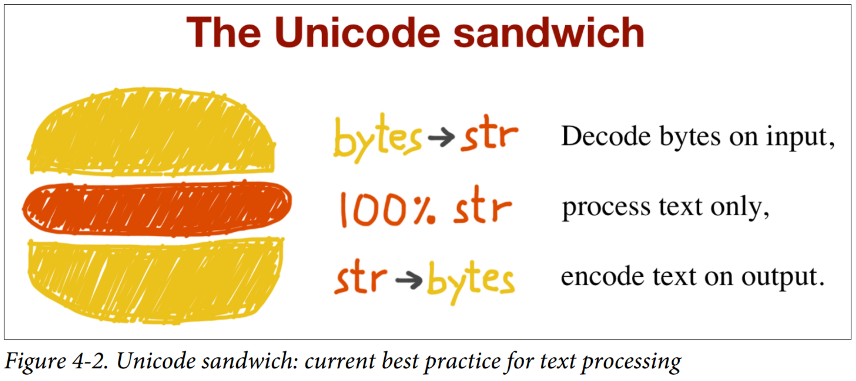
Handling text files best practice
Notes:
bytes should be decoded to str as early as possible on input (i.e. opening a file for reading)
“meat” of sandwich is text handling done exclusively on str objects
never decode/encode in the middle of other processing
output – str are encoded to bytes as late as possible

Slide 37
Handling text files
Python 3 built-in open
does necessary decoding when reading
does necessary encoding when writing
...still be careful with relying on default encodings
Example: developing code that runs on multiple machines

Slide 38
Discussion
1. What file types in biology might have a specific encoding?
2. Do we need to care about the specific type of encoding used?
when storing/transferring data?
when writing scripts for analyses?
when data mining?
when converting file formats?
Notes:
BAM files
To some extent, yes
we store big data, computer can only store and work with bits
bits can only have 2 values: yes or no, true or false, 1 or 0
speed of processing

Slide 39
Additional References
What every programmer absolutely positively needs to know about encodings and character sets to work with text by David C. Zentgraf

